Slide 1
Project Proposal: Python Game using Raspberry Pi
By: Saman Sandhu

Slide 2
Description of Project

Slide 3


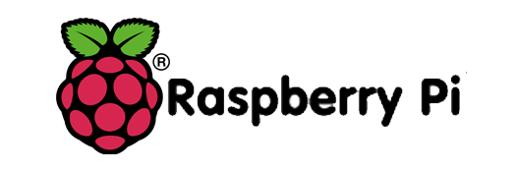

Story
Python game using the raspberry pi as a means of a controller
The game itself will be set underwater, where the user is the captain of the submarine
Objective - explore the underwater sea world and avoid death
Avoid Death
moving up and down in depth in the ocean, and use missiles to avoid numerous great white sharks and killer whales

Slide 4

Specifics
Captain has an arsenal of 10 missiles due to his involvement in an extremely dangerous mission
STAGE 1 - (Easy round) Great White Sharks.
STAGE 2 will be similar except a bit faster.
STAGE 3 - Killer Whales
STAGE 4 will be similar except a bit faster
STAGE 5 Great White Sharks & Killer Whales

Slide 5
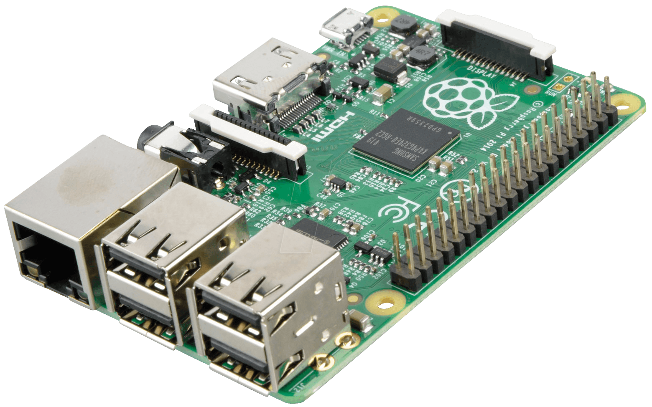
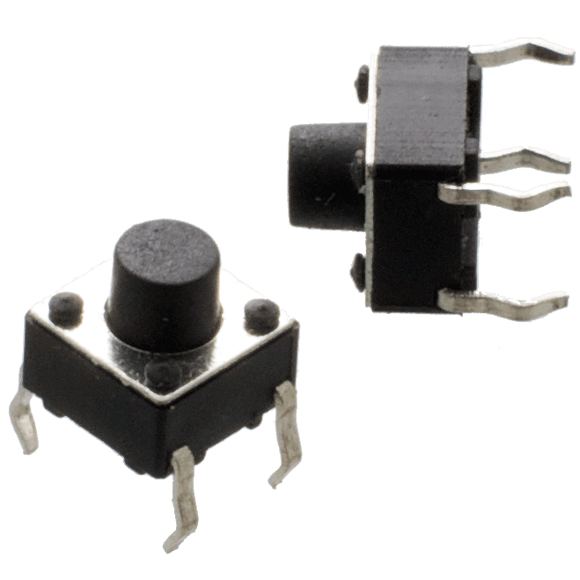
Controller
Controller - raspberry pi as a game controller.
Buttons - The controller will have 5 buttons
2 of which are for submarine depth control.
Another 2 will be connected to a green and red led to show whether the game is running, paused, at the start or end screen.
The last button is used for the function of firing missiles.

Slide 6
Timeline

Slide 7
Programming Major Stages
Hardware Major Stages
Create objects in the game
Start working on game loop and move player
Collision detection and crash function
Add missiles
Score Display Functions
Pause Functions
Game intro function
Add Stages
Add Lives function (so player has 3 lives)
Troubleshoot
Troubleshoot
Troubleshoot
Troubleshoot
Hook up a circuit with the 2 buttons for submarine depth control
Use inputs of the button to make the player move
Add a button for the missiles
Add 2 buttons for start, pause and end function
Troubleshoot
Troubleshoot
Troubleshoot
Troubleshoot

Slide 8
Essential Learning

Slide 9
Systems I will:
follow appropriate health and safety procedures when assembling, using, and maintaining computer systems, following acceptable use policies
Fundamentals I will:
demonstrate an application of electronics theory in design and problem solving
apply fundamental programming concepts to develop a variety of simple programs, including a program to control an external device
Electronics I will:
construct and test simple interfaces and other electronic circuits
identify and describe the electronic theory, and the functions of electronic and computer components
Programming I will:
apply fundamental programming concepts to develop a variety of programs, including a program to control an external device, and inter-device communication.
use a procedural programming language to define constants and variables, write expressions and assignment statements, and specify the order in which the operations are performed in a program

Slide 10
Materials

Slide 11

Materials and Budget
Raspberry pi
Python
Pygame
Wiring
Buttons
LEDs
Cardboard
Pen

Slide 12
Conclusion

